Slide 1
Chapter 1 Introduction: Matter and Measurement
Chemistry, The Central Science, 10th edition
Theodore L. Brown; H. Eugene LeMay, Jr.; and Bruce E. Bursten

Slide 2
Learning Goals:
By the end of class you will be able to…
Classify matter into its states and substances.
Distinguish between physical and chemical changes and properties.
Give examples of mixture separation techniques.

Slide 3
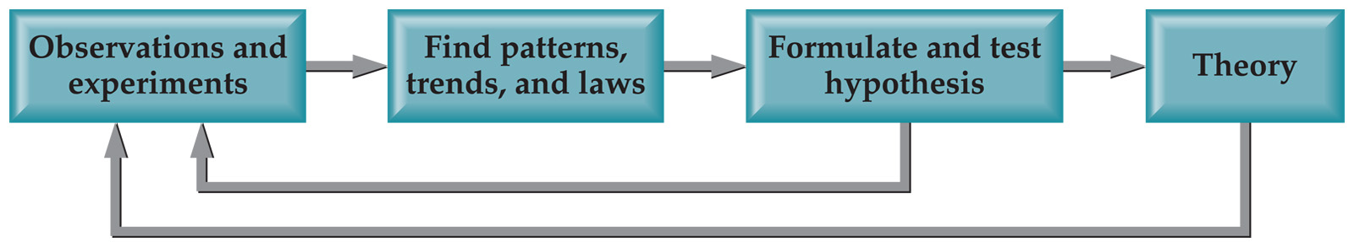
Scientific Method:
A systematic approach to solving problems.
Empirical
Facts
A model
The testing and retesting
This is what makes it Science!

Slide 4
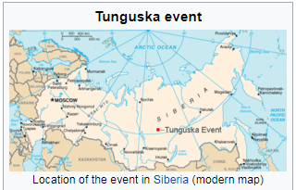
Facts and theories
*Fact: on June 30, 1908 in Tunguska, Siberia, an explosion equivalent to about 15 million tons of TNT occurred.
* Hypothesis is that a comet or meteor collided with the Earth.
Testing: look for elements and substances characteristic of extraterrestrial objects, elements not found in the area. Such elements (Nickel, Iridium) were found.
However, there is no crater.
Theory: Meteor exploded above the ground.

Slide 5
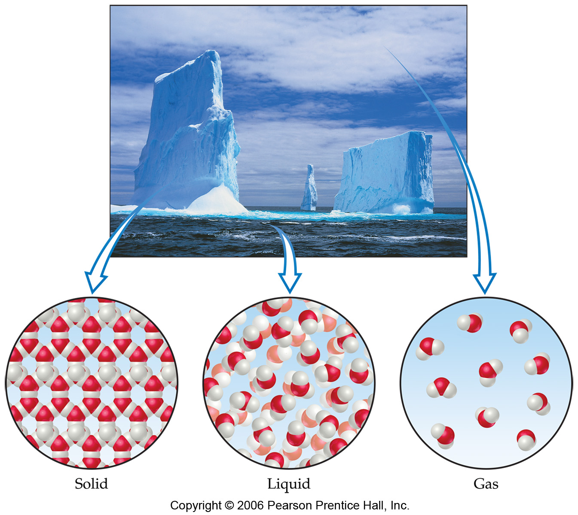
Chemistry:
The study of matter and the changes it undergoes.

Slide 6
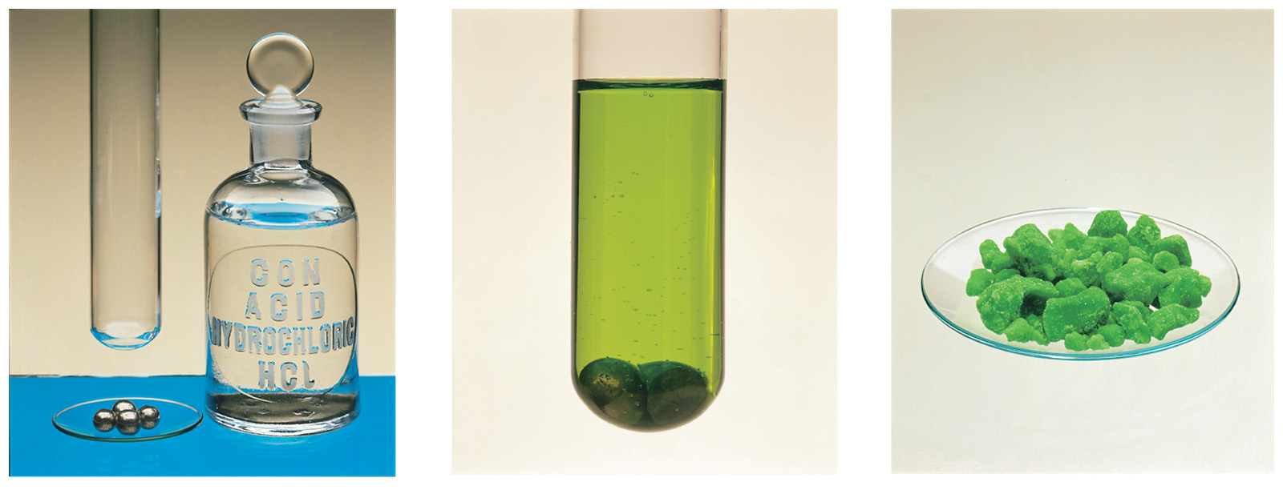
Matter:
Anything that has mass and takes up space.

Slide 7
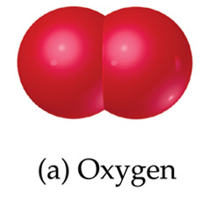
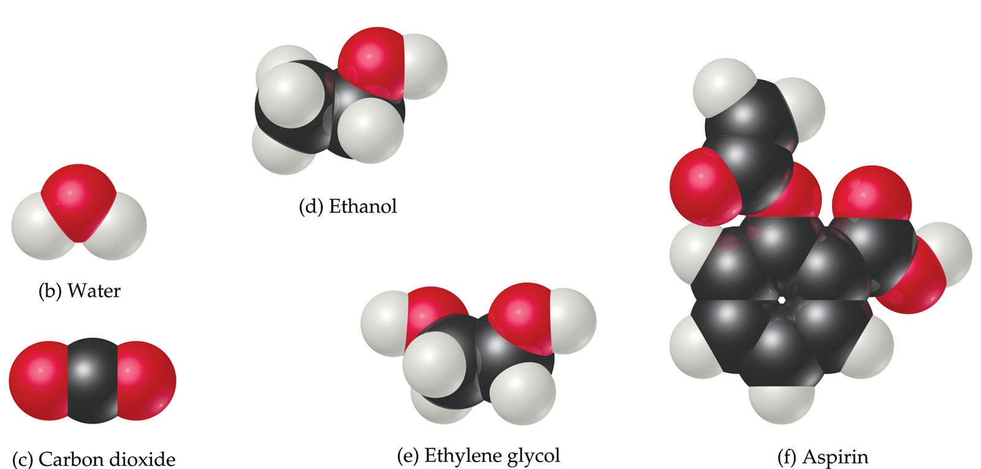
Matter
Atoms are the building blocks of matter.

Slide 8
Matter
Each element is made of the same kind of atom.

Slide 9
Matter
A compound is made of two or more different kinds of elements.

Slide 10
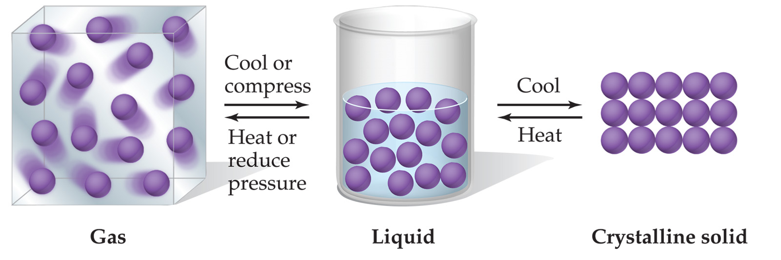
States of Matter
pressure
Can interchange by a manipulation of ____________ and _________________.
temperature

Slide 11
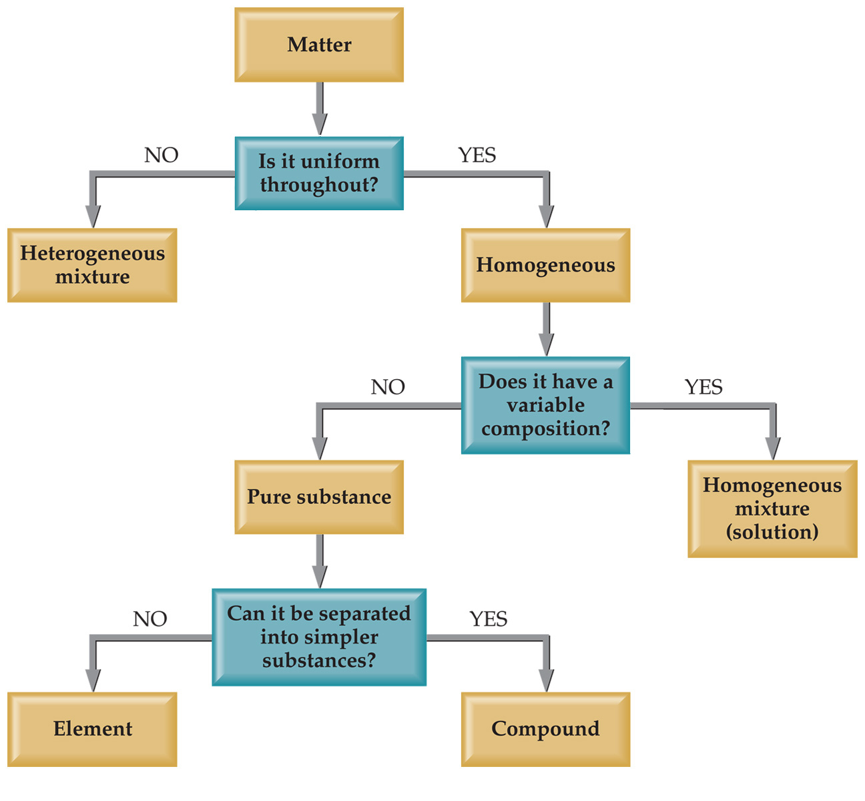
Classification of Matter
Mud
salt water
water
salt water
oxygen
water

Slide 12
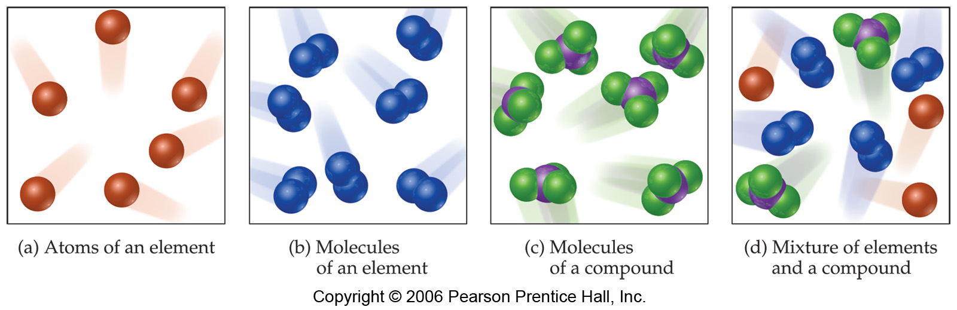
Mixtures and Compounds
Element
(atoms)
Compound
(molecules)
Compound
(molecules)
Mixture
He, Ne
N₂, O₂, Cl₂
CO₂, H₂O, NH₃
Mix

Slide 13
Properties and Changes of Matter

Slide 14
Properties of Matter
Physical Properties:
Must be observed without changing a compound/element into another compound/element.
Boiling point, density, mass, volume, etc.
Chemical Properties:
Can only be observed when a compound/element is changed into another compound/element.
Flammability, corrosiveness, reactivity with acid, etc.

Slide 15
Properties of Matter
Intensive Properties:
Independent of the amount of the matter that is present.
Density, boiling point, colour, etc.
Extensive Properties:
Dependent upon the amount of the matter present.
Mass, volume, energy, etc.

Slide 16
Changes of Matter
Physical Changes:
Changes in matter that do not change the composition of a substance.
Changes of state, temperature, volume, etc.
Chemical Changes:
Changes that result in new substances.
Combustion, oxidation, decomposition, etc.

Slide 17
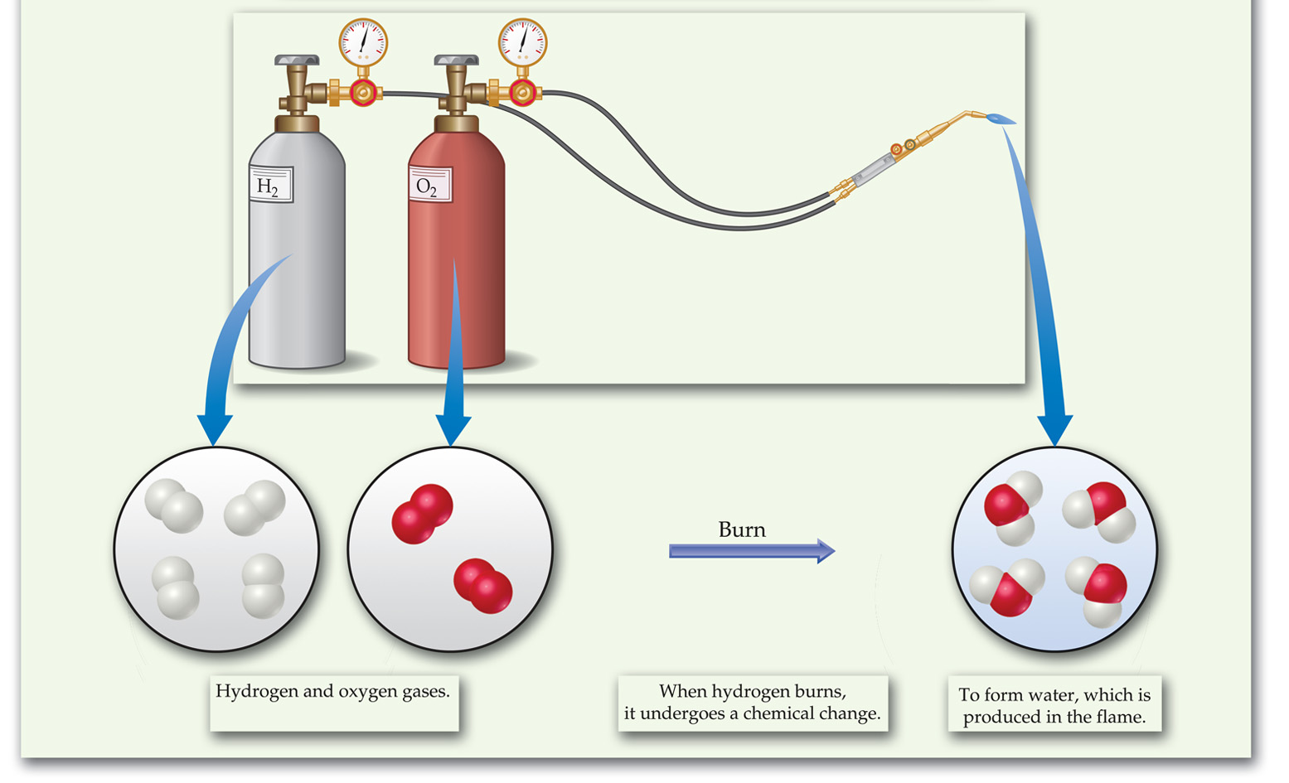
Chemical Reactions
In the course of a chemical reaction, the reacting substances are converted to new substances.

Slide 18
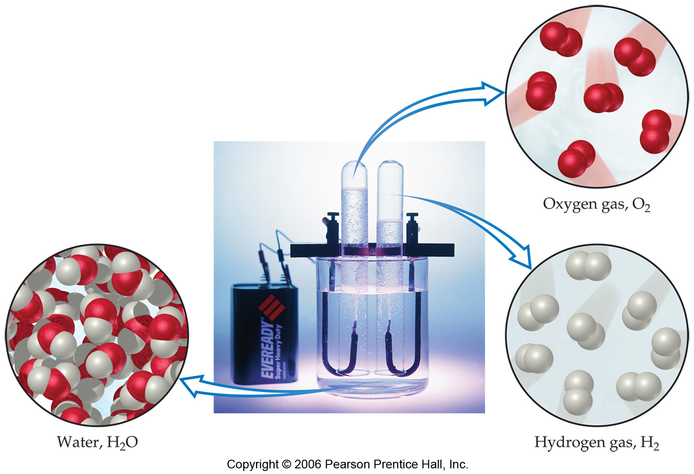
Compounds
Compounds can be broken down into elements.

Slide 19
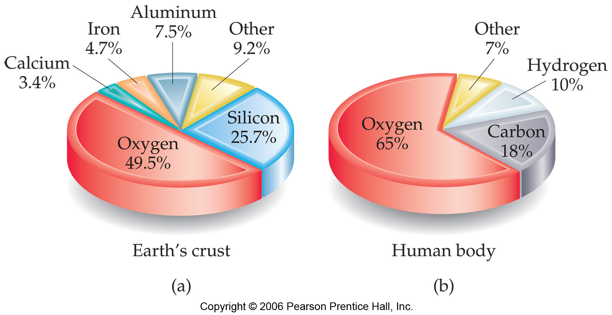
Relative abundance of elements

Slide 20
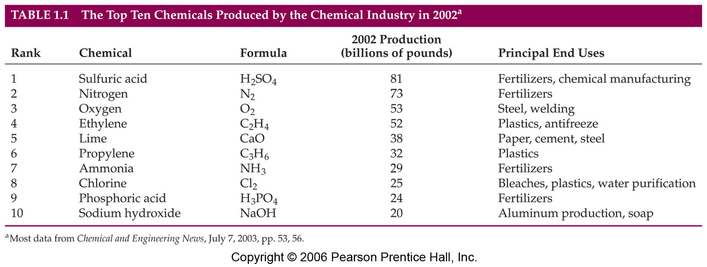
Acids
Bases
Pure elements

Slide 21
Separation of Mixtures

Slide 22
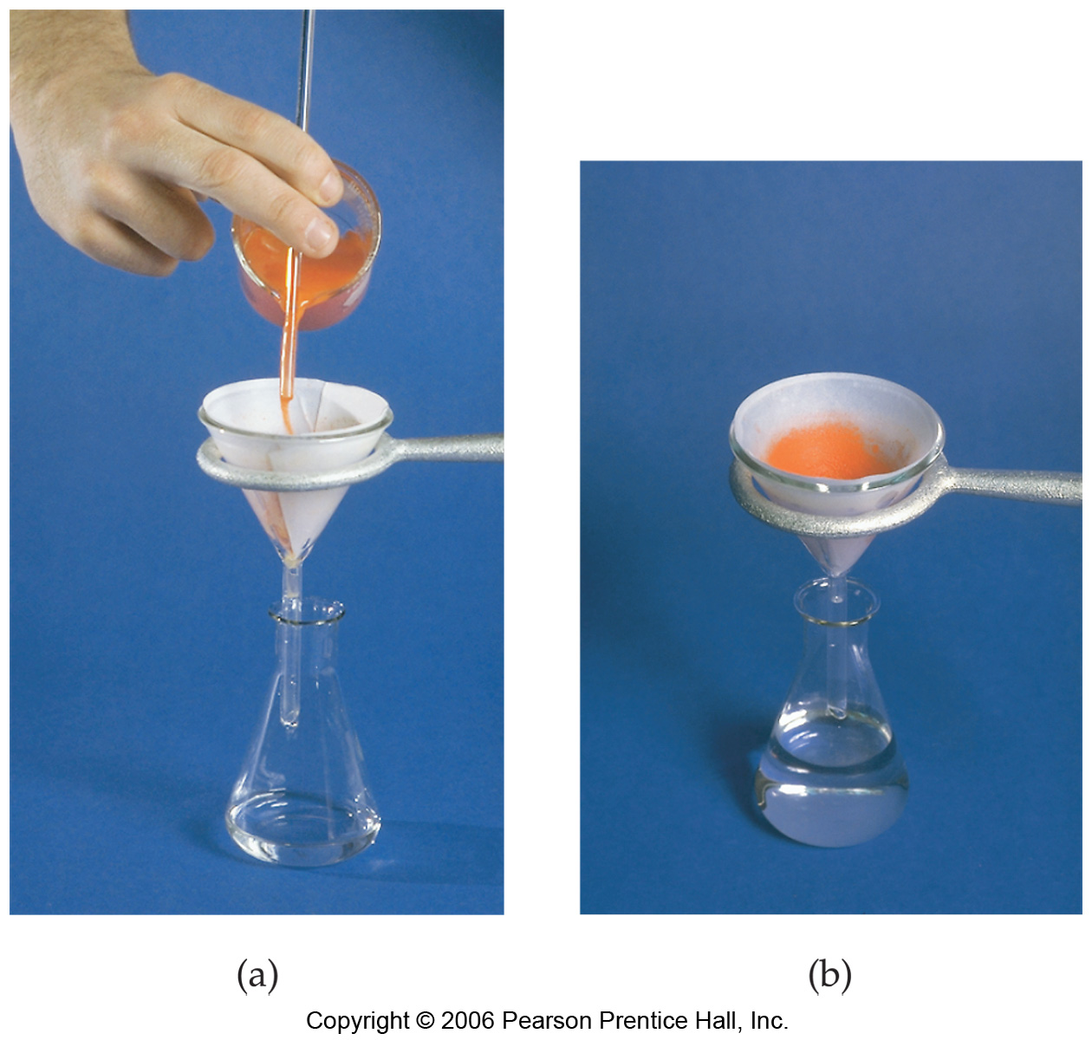
Filtration:
Separates a heterogeneous mixture; solid substances from liquids and solutions.

Slide 23
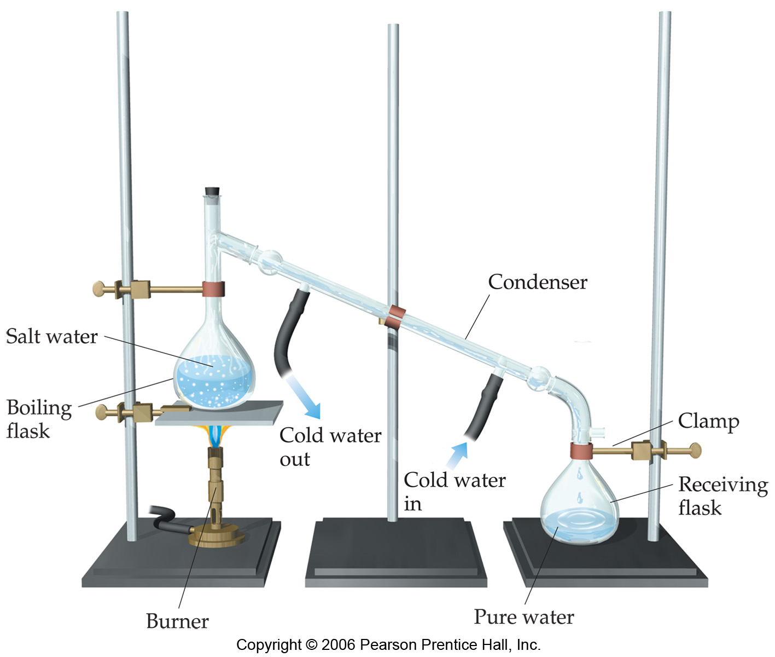
Distillation:
Separates a homogeneous mixture of liquids on the basis of differences in boiling point.

Slide 24
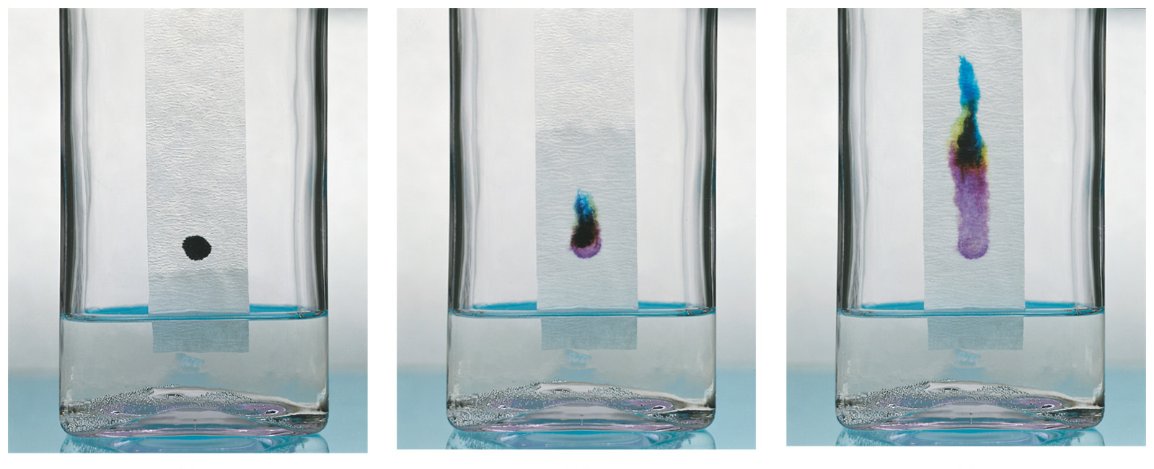
Chromatography:
Separates homogeneous mixtures on the basis of differences in solubility in a solvent, or in binding to a solid matrix.
Separation techniques were critical to the development of the basic theories of chemistry.
How do we know there are homogeneous mixtures? We can separate them.

Slide 25
Homework
Read pp. 4-14
Exercises #1.1-1.4, 1.11, 1.13, 1.15*, 1.17, 1.19, 1.21
☺

